Slide 1
Capital in the 21st century
Thomas Piketty
Paris School of Economics
Tokyo, January 29 2015

Slide 2
This presentation is based upon Capital in the 21st century (Harvard University Press, March 2014)
This book studies the global dynamics of income and wealth distribution since 18^{c} in 20+ countries; I use historical data collected over the past 15 years with Atkinson, Saez, Postel-Vinay, Rosenthal, Alvaredo, Zucman, and 30+ others; I try to shift attention from rising income inequality to rising wealth inequality
The book includes four parts:
Part 1. Income and capital
Part 2. The dynamics of the capital/income ratio
Part 3. The structure of inequalities
Part 4. Regulating capital in the 21st century
In this presentation I will present some results from Parts 2 & 3, focusing upon the long-run evolution of capital/income ratios and wealth concentration (all graphs and series are available on line:
see http://piketty.pse.ens.fr/capital21c )

Slide 3
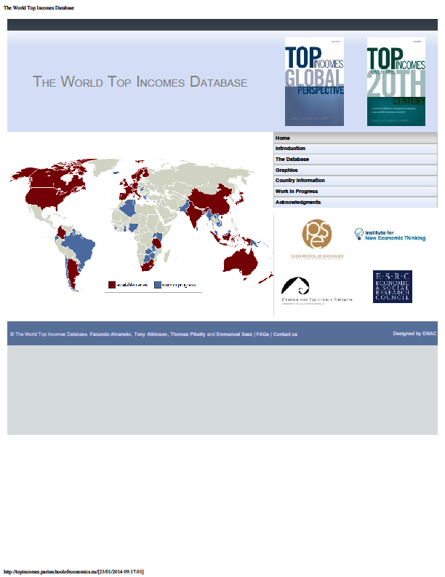

Slide 9
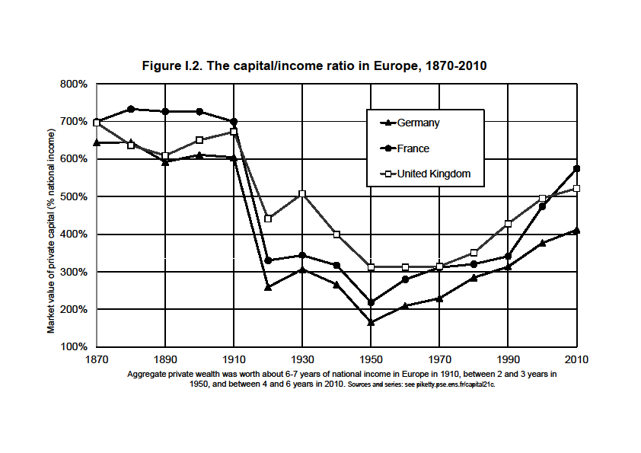

Slide 10
This presentation: three points
1. The return of a patrimonial (or wealth-based) society in the Old World (Europe, Japan). Wealth-income ratios seem to be returning to very high levels in low growth countries. Intuition: in a slow-growth society, wealth accumulated in the past can naturally become very important. In the very long run, this can be relevant for the entire world.
2. The future of wealth concentration: with high r - g during 21^{c} (r = net-of-tax rate of return, g = growth rate), then wealth inequality might reach or surpass 19^{c} oligarchic levels; conversely, suitable institutions can allow to democratize wealth.
3. Inequality in America (« meritocratic extremism »): is the New World developing a new inequality model that is based upon extreme labor income inequality more than upon wealth inequality? Is it more merit-based, or can it become the worst of all worlds?

Slide 12
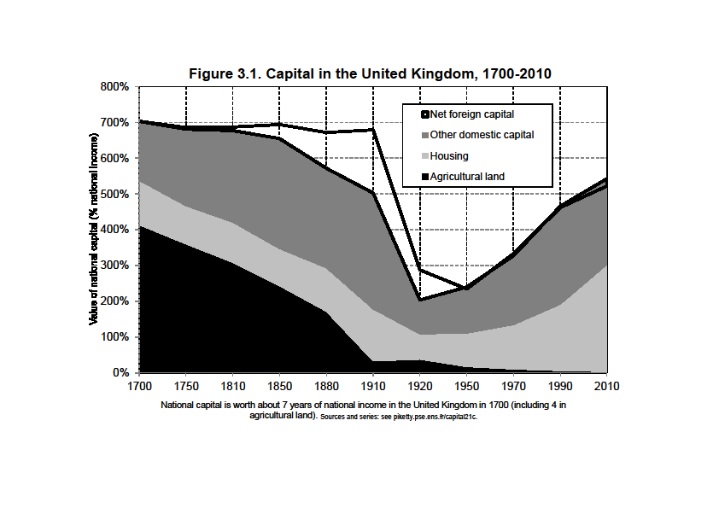

Slide 13
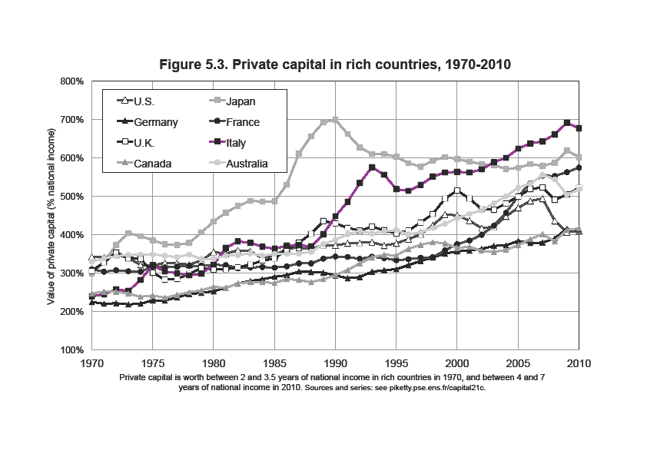

Slide 15
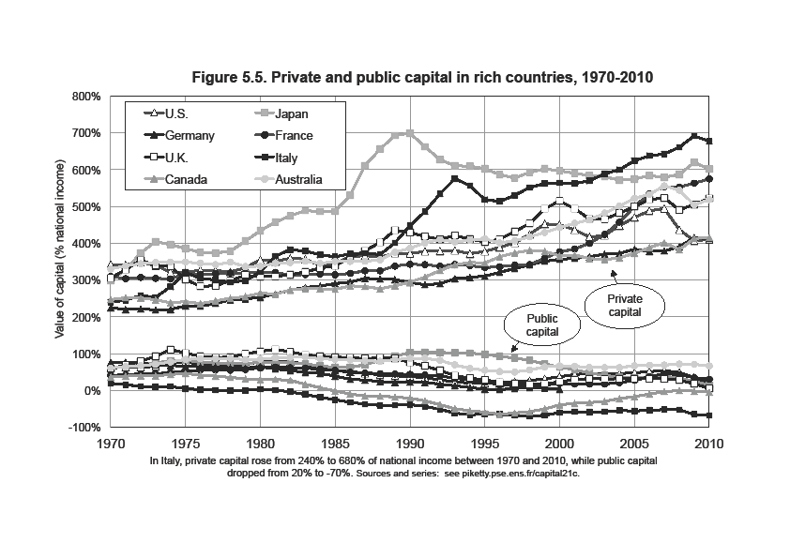

Slide 16
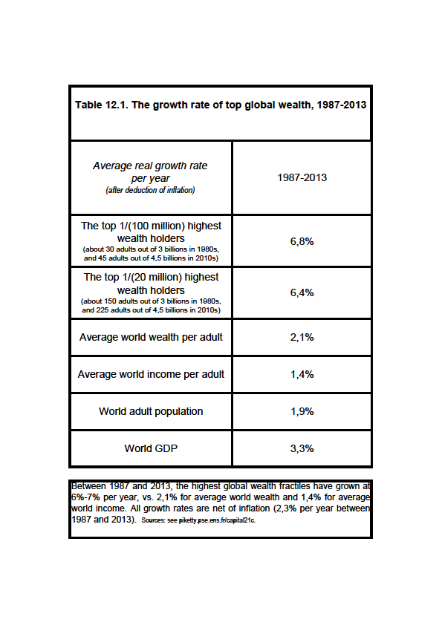

Slide 17
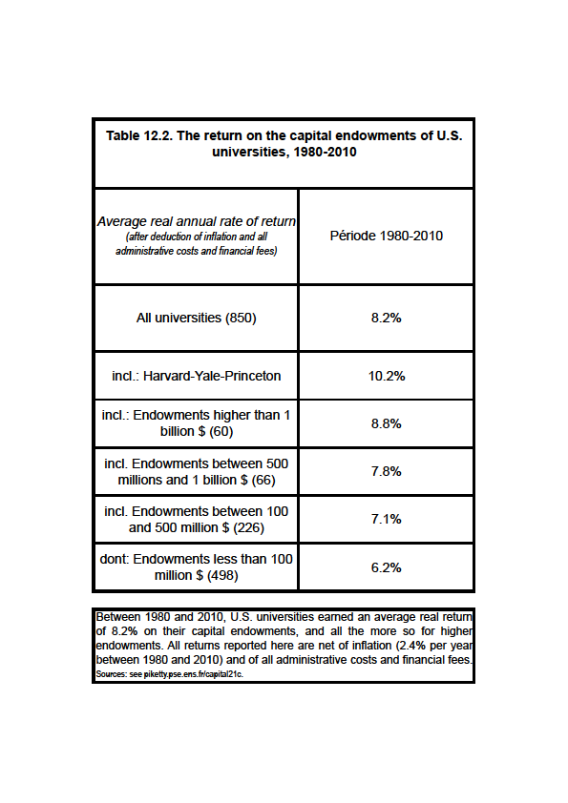

Slide 18
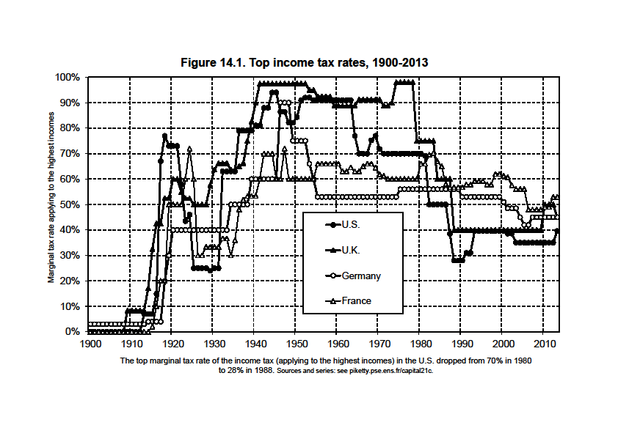

Slide 20
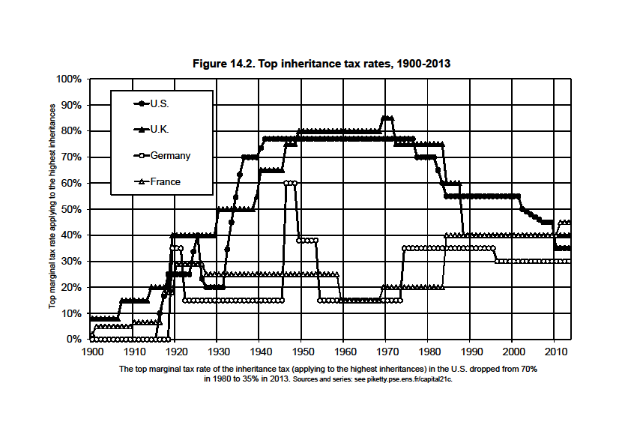

Slide 21
Supplementary slides
(long lecture version)

Slide 22
This presentation: three points
1. The return of a patrimonial (or wealth-based) society in the Old World (Europe, Japan). Wealth-income ratios seem to be returning to very high levels in low growth countries. Intuition: in a slow-growth society, wealth accumulated in the past can naturally become very important. In the very long run, this can be relevant for the entire world.
2. The future of wealth concentration: with high r - g during 21^{c} (r = net-of-tax rate of return, g = growth rate), then wealth inequality might reach or surpass 19^{c} oligarchic levels; conversely, suitable institutions can allow to democratize wealth.
3. Inequality in America (« meritocratic extremism »): is the New World developing a new inequality model that is based upon extreme labor income inequality more than upon wealth inequality? Is it more merit-based, or can it become the worst of all worlds?

Slide 23
1. The return of a wealth-based society
Wealth = capital K = everything we own and that can be sold on a market (net of all debts) (excludes human K, except in slave societies)
In textbooks, wealth-income & capital-ouput ratios are supposed to be constant. But the so-called « Kaldor facts » actually rely on little historical evidence.
In fact, we observe in Europe & Japan a large recovery of β=K/Y in recent decades:
β=200-300% in 1950-60s → β=500-600% in 2000-10s
(i.e. average wealth K was about 2-3 years of average income Y around 1950-1960; it is about 5-6 years in 2000-2010)
(with β≈600%, if Y≈30 000€ per capita, then K≈180 000€ per capita)
(currently, K ≈ half real estate, half financial assets)
Are we heading back to the β=600-700% observed in the wealth-based societies of 18^{c}-19^{c} ? Or even more?

Slide 26
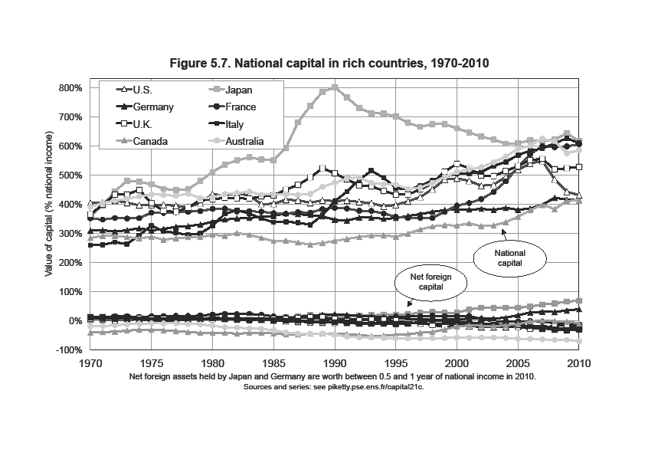

Slide 28
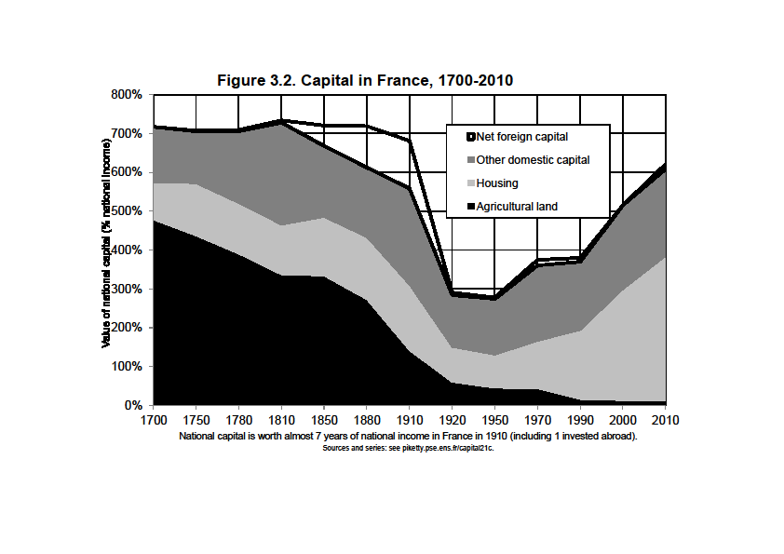

Slide 29
The simplest way to think about this is the following: in the long-run, β=s/g with s = (net-of-depreciation) saving rate
and g = economy’s growth rate (population + productivity)
With s=10%, g=3%, β≈300%; but if s=10%, g=1,5%, β≈600%
= in slow-growth societies, the total stock of wealth accumulated in the past can naturally be very important
→ capital is back because low growth is back
(in particular because population growth↓0)
→ in the long run, this can be relevant for the entire planet
Note: β=s/g = pure stock-flow accounting identity; it is true whatever the combination of saving motives

Slide 30
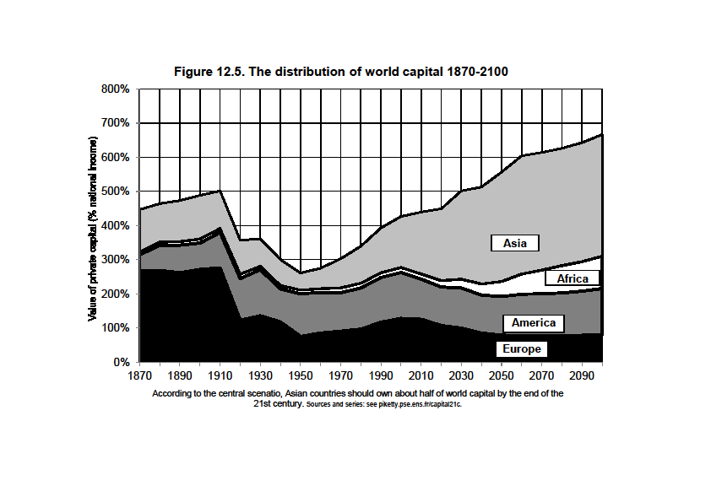

Slide 31
Will the rise of capital income-ratio β also lead to a rise of the capital share α in national income?
If the capital stock equals β=6 years of income and the average return to capital is equal r=5% per year, then the share of capital income (rent, dividends, interest, profits, etc.) in national income equals α = r x β = 30%
Technically, whether a rise in β also leads to a rise in capital share α = r β depends on the elasticity of substitution σ between capital K and labor L in the production function Y=F(K,L)
Intuition: σ measures the extent to which workers can be replaced by machines (e.g. Amazon’s drones)
Standard assumption: Cobb-Douglas production function (σ=1) = as the stock β↑, the return r↓ exactly in the same proportions, so that α = r x β remains unchanged, like by magic = a stable world where the capital-labor split is entirely set by technology
But if σ>1, then the return to capital r↓ falls less than the volume of capital β↑, so that the product α = r x β ↑
Exactly what happened since the 1970s-80s: both the ratio β and the capital share α have increased

Slide 32
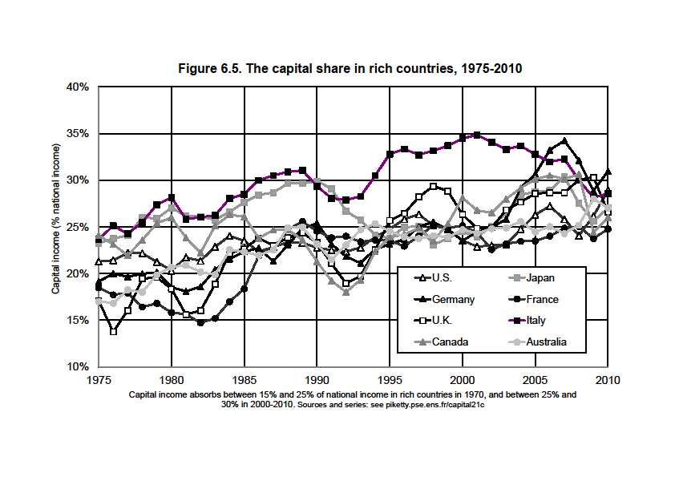

Slide 33
With a large rise in β, one can get large rise in α with a production function F(K,L) that is just a little bit more substituable than in the standard Cobb-Douglas model (say if σ=1,5 instead of 1)
Maybe it is natural to expect σ↑over the course of history: more and more diversified uses for capital; extreme case: pure robot-economy (σ=infinity)
Less extreme case: there are many possible uses for capital (machines can replace cashiers, drones can replace Amazon’s delivery workers, etc.), so that the capital share α↑ continuously; there’s no natural corrective mechanism for this
The rise of β and α can be a good thing (we could all devote more time to culture, education, health…, rather than to our own subsistance), assuming one can answer the following question: who owns the robots?

Slide 34
2. The future of wealth concentration
In all European countries (UK, France, Sweden…), wealth concentration was extremely high in 18^{c}-19^{c} & until WW1:
about 90% of aggregate wealth for top 10% wealth holders
about 60% of aggregate wealth for top 1% wealth-holders
= the classic patrimonial (wealth-based) society: a minority lives off its wealth, while the rest of the populaton works (Austen, Balzac)
Today wealth concentration is still very high, but less extreme:
about 60-70% for top 10%; about 20-30% for top 1%
the bottom 50% still owns almost nothing (<5%)
but the middle 40% now owns 20-30% of aggregate wealth
= the rise of a patrimonial middle class
How did it happen, and will it last? Will the patrimonial middle class expend, or will it shrink?

Slide 35
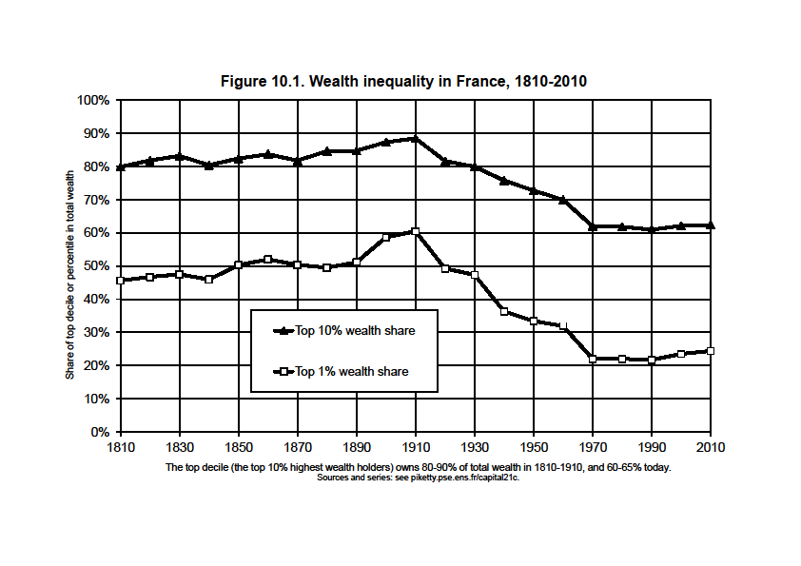

Slide 36
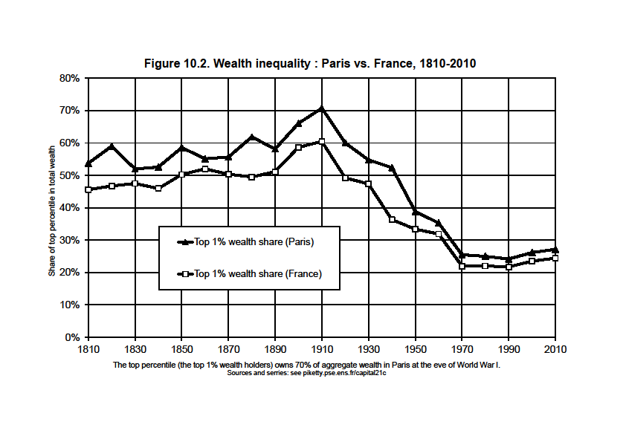

Slide 37
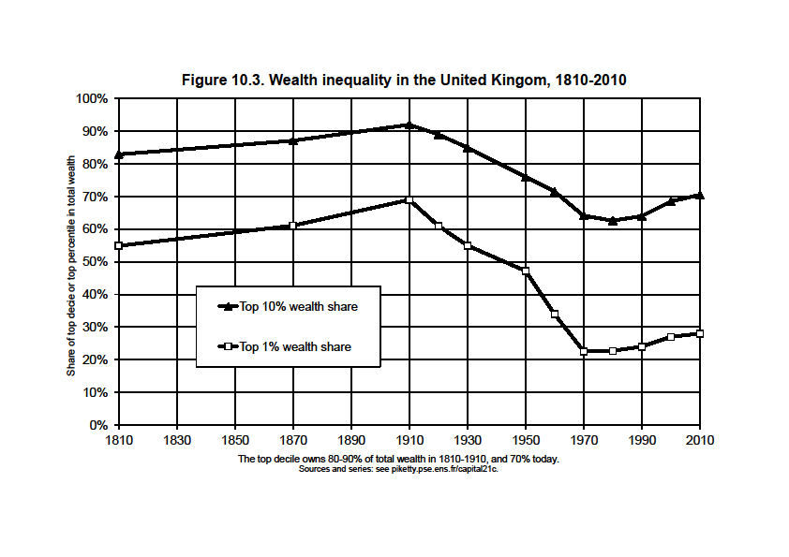

Slide 38
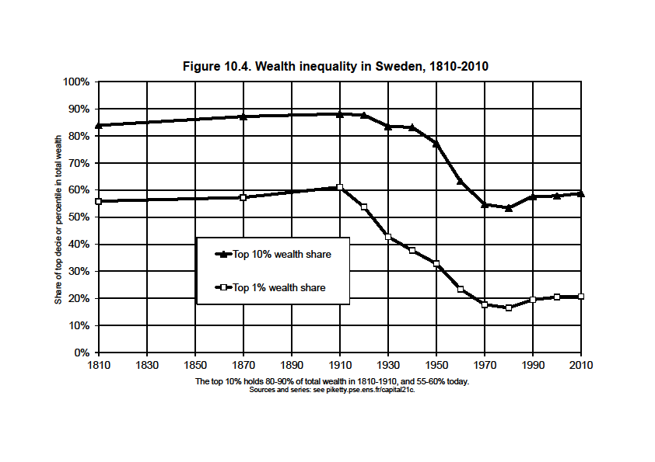

Slide 39
Key finding: there was no decline in wealth concentration prior to World War shocks; was it just due to shocks?
Q.: Apart from shocks, what forces determine the long-run level of wealth concentration?
A.: In any dynamic, multiplicative wealth accumulation model with random individual shocks (tastes, demographic,returns, wages,..), the steady-state level of wealth concentration is an increasing function of r - g
(with r = net-of-tax rate of return and g = growth rate)
With growth slowdown and rising tax competition to attract capital, r - g might well rise in the 21^{c} → back to 19^{c} levels
Future values of r also depend on technology (σ>1?)
Under plausible assumptions, wealth concentration might reach or surpass 19^{c} record levels: see global wealth rankings

Slide 40
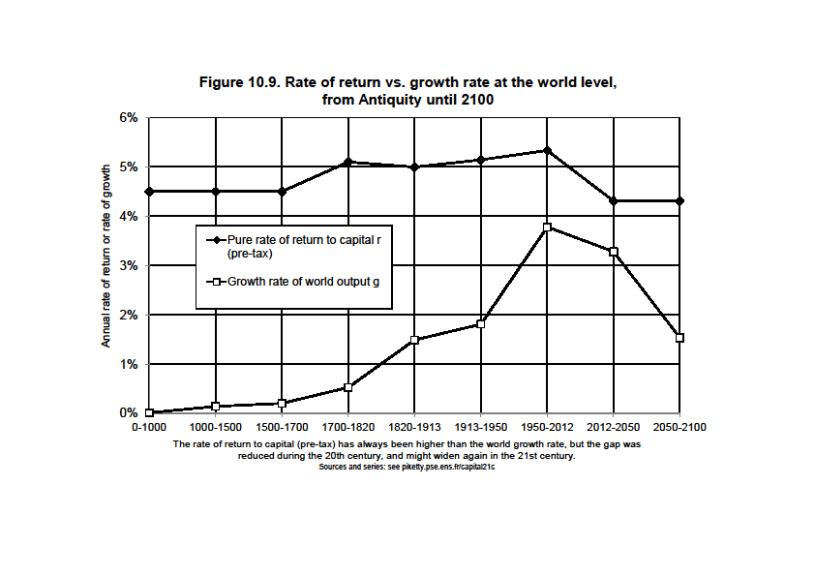

Slide 41
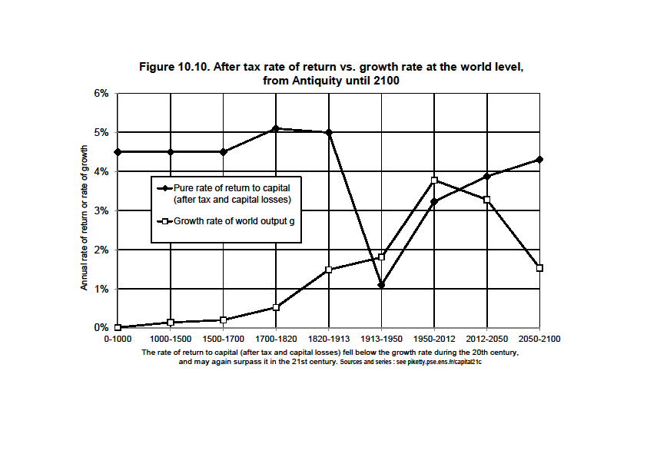

Slide 42
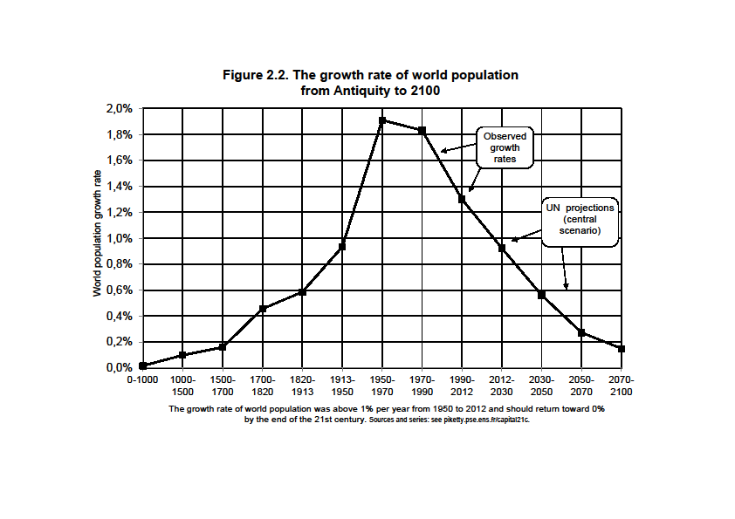

Slide 43
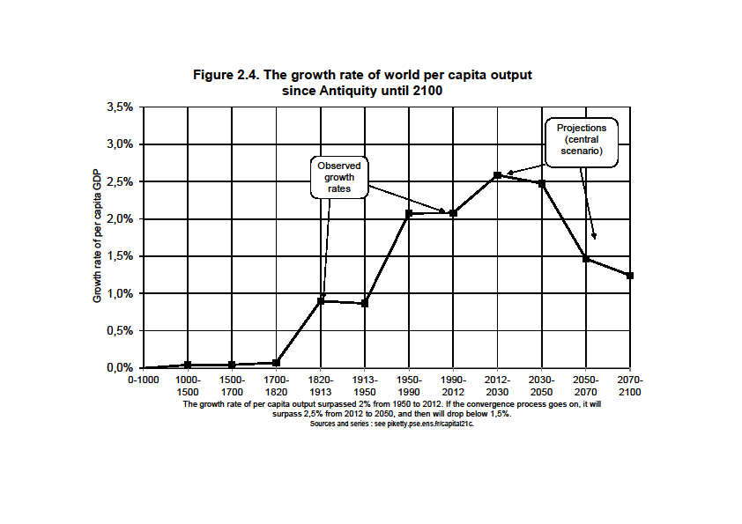

Slide 44
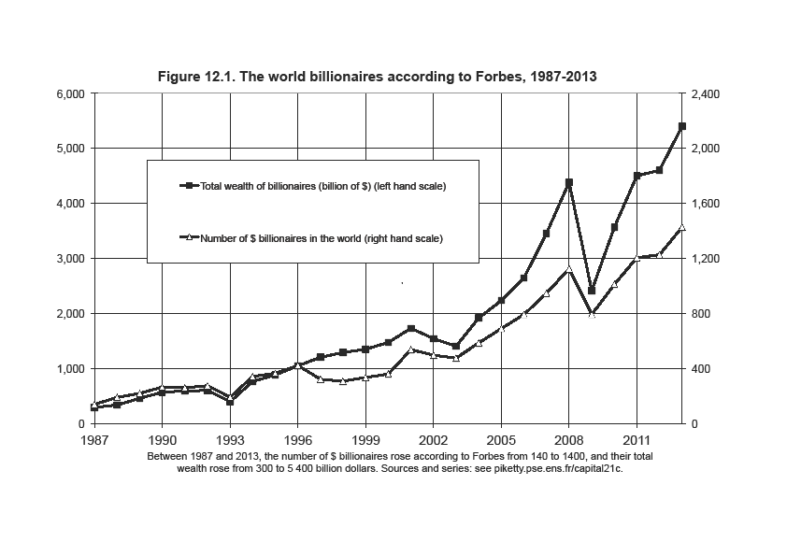

Slide 45
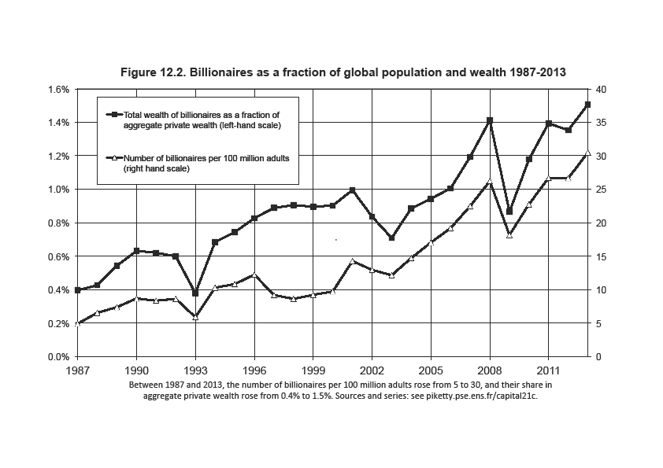

Slide 46
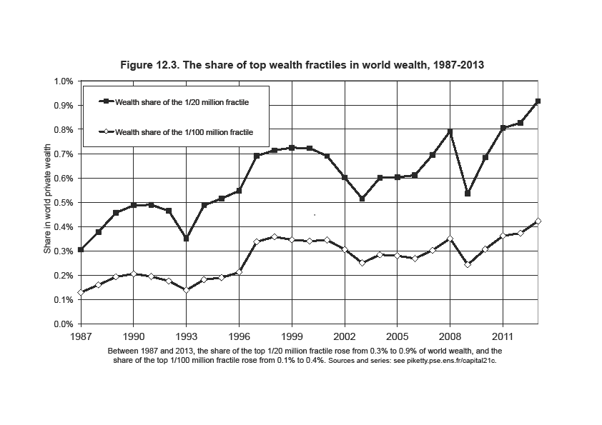

Slide 49
3. Inequality in America
(« meritocratic extremism »)
Inequality in America = a different structure as in Europe: more egalitarian in some ways, more inegalitarian in some other dimensions
The New World in the 19th century: the land of opportunity (capital accumulated in the past mattered much less than in Europe; perpetual demographic growth as a way to reduce the level of inherited wealth and wealth concentration)… and also the land of slavery
Northern US were in many ways more egalitarian than Old Europe; but Southern US were more inegalitarian
We still have the same ambiguous relationship of America with inequality today: in some ways more merit-based; in other ways more violent (prisons)

Slide 51
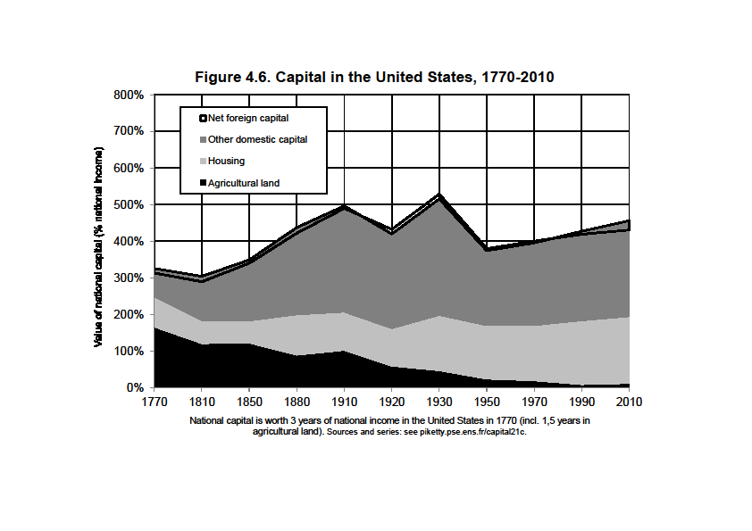

Slide 52
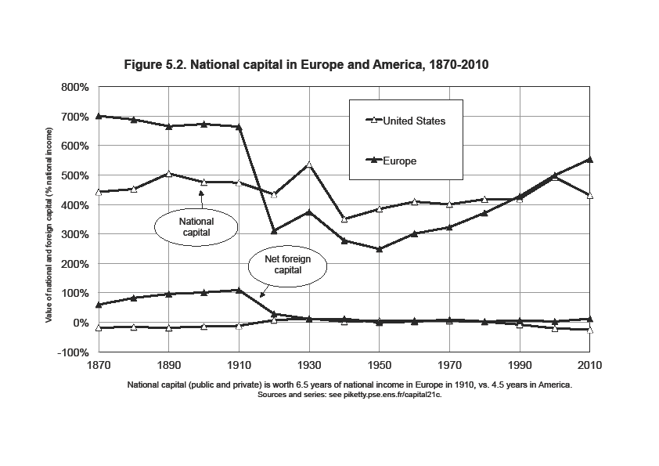

Slide 53
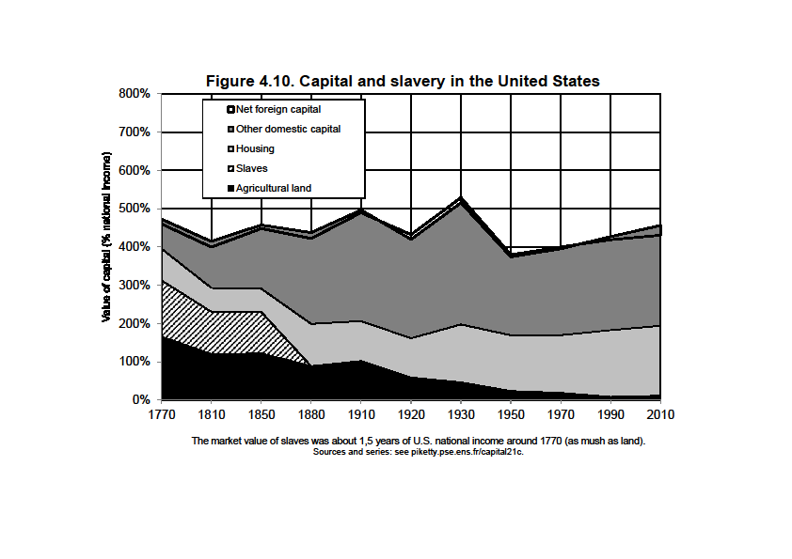

Slide 54
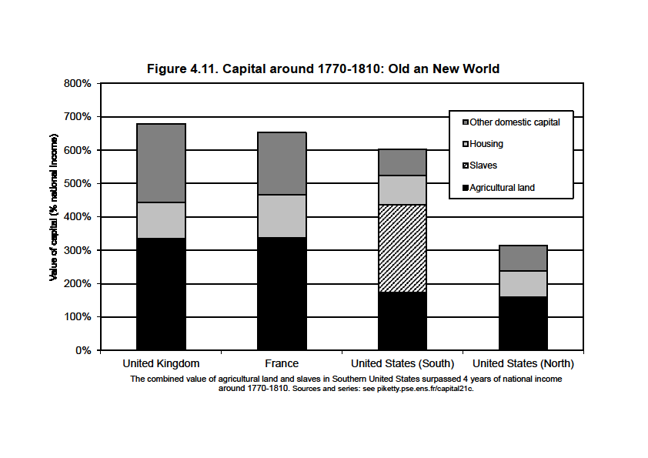

Slide 55
The US distribution of income has become more unequal than in Europe over the course of the 20th century; it is now as unequal as pre-WW1 Europe
But the structure of inequality is different: US 2013 has less wealth inequality than Europe 1913, but higher inequality of labor income

Slide 56
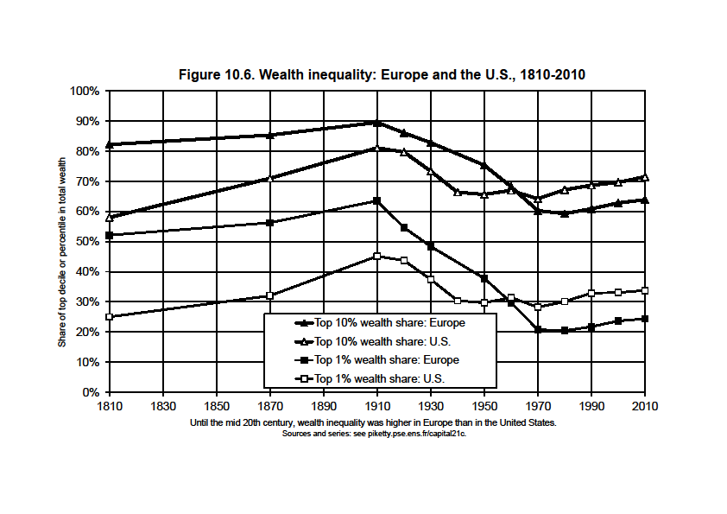

Slide 57
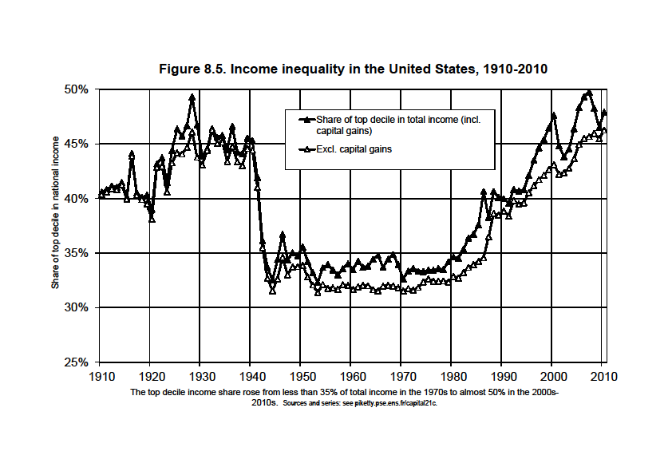

Slide 58
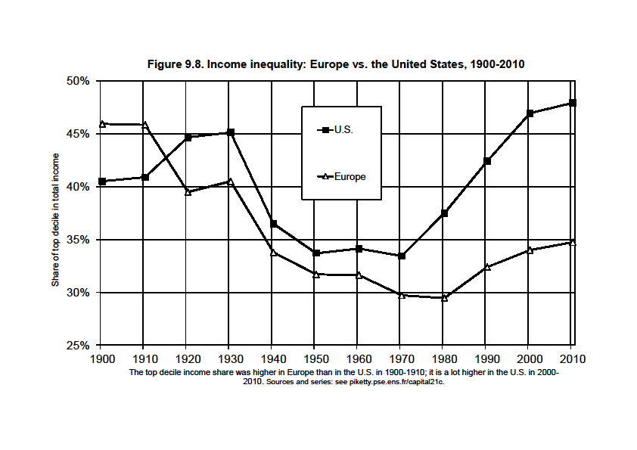

Slide 59
Higher inequality of labor income in the US could reflect higher inequality in education investment; but it also reflects a huge rise of top executive compensation that it very hard to explain with education and productivity reasonning alone
In the US, this is sometime described as more merit-based: the rise of top labor incomes makes it possible to become rich with no inheritance (≈Napoleonic prefets)
Pb = this can be the worst of all worlds for those who are neither top income earners nor top successors: they are poor, and they are depicted as dump & undeserving (at least, nobody was trying to depict Ancien Regime inequality as fair)
It is unclear whether rise of top incomes has a lot to do with merit or productivity: sharp decline in top tax rates & rise of CEO bargaining power are more convincing explanations; chaotic US history of social norms regarding inequality

Slide 62
Conclusions
The history of income and wealth inequality is always political, chaotic and unpredictable; it involves national identities and sharp reversals; nobody can predict the reversals of the future
Marx: with g=0, β↑∞, r→0 : revolution, war
My conclusions are less apocalyptic: with g>0, at least we have a steady-state β=s/g
But with g>0 & small, this steady-state can be rather gloomy: it can involve a very large capital-income ratio β and capital share α, as well as extreme wealth concentration due to high r-g
This has nothing to do with a market imperfection: the more perfect the capital market, the higher r-g
The ideal solution: progressive wealth tax at the global scale, based upon automatic exchange of bank information
Other solutions involve authoritarian political & capital controls (China, Russia..), or perpetual population growth (US), or inflation, or some mixture of all

